Slide 1

Year 9 Investigation 1 - Modelling Population Growth
By Henry Sun :D
With visual representations using egg Andre :D

Slide 2
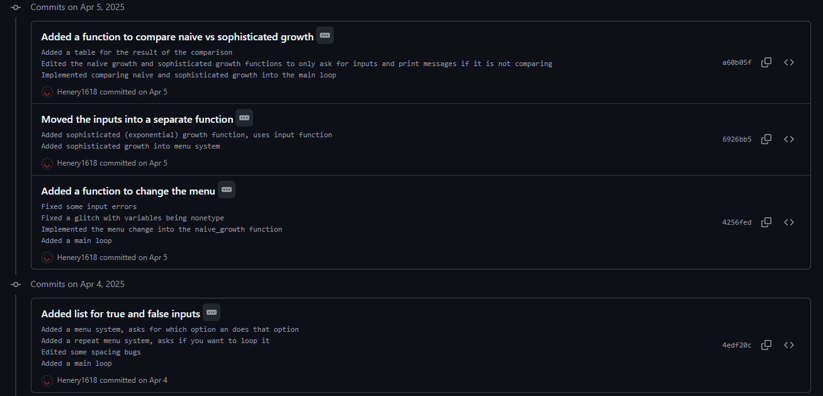
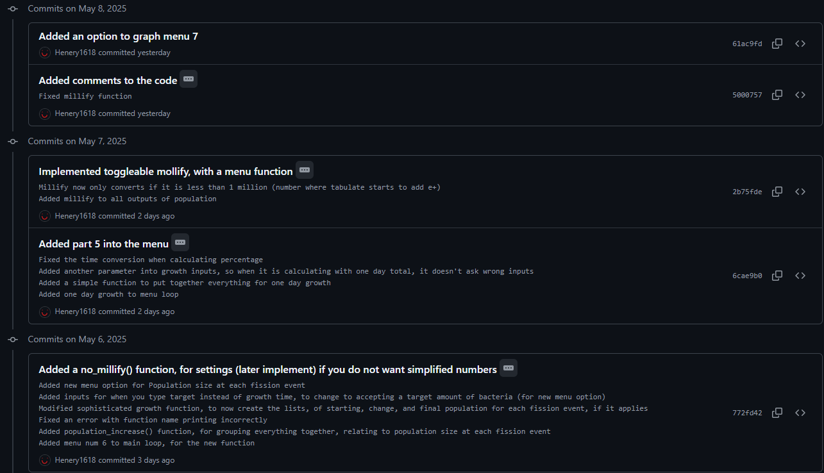
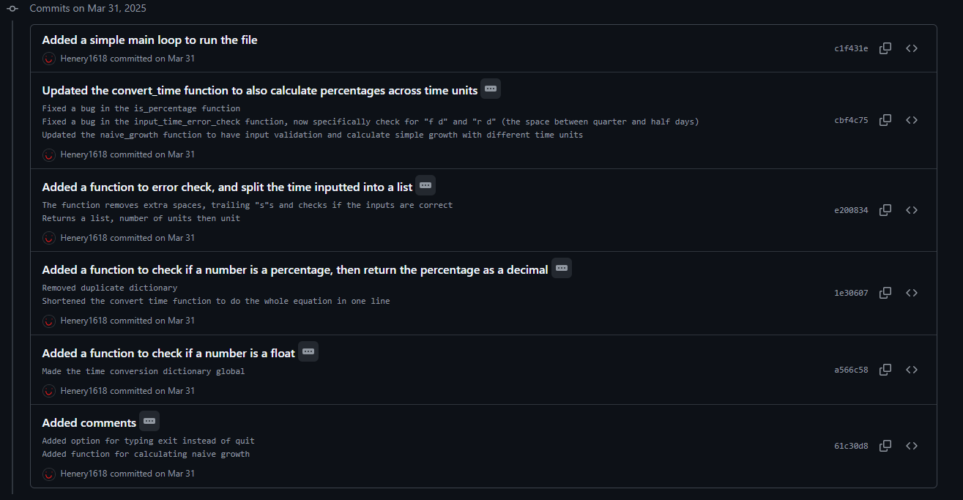
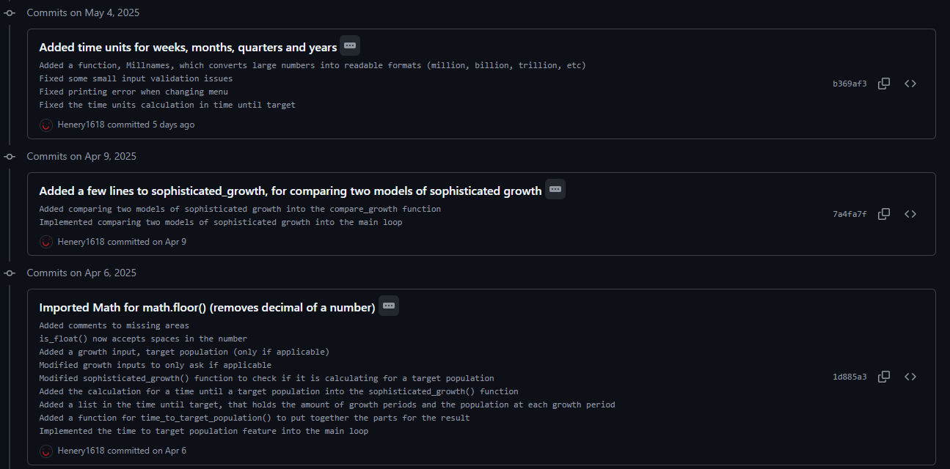
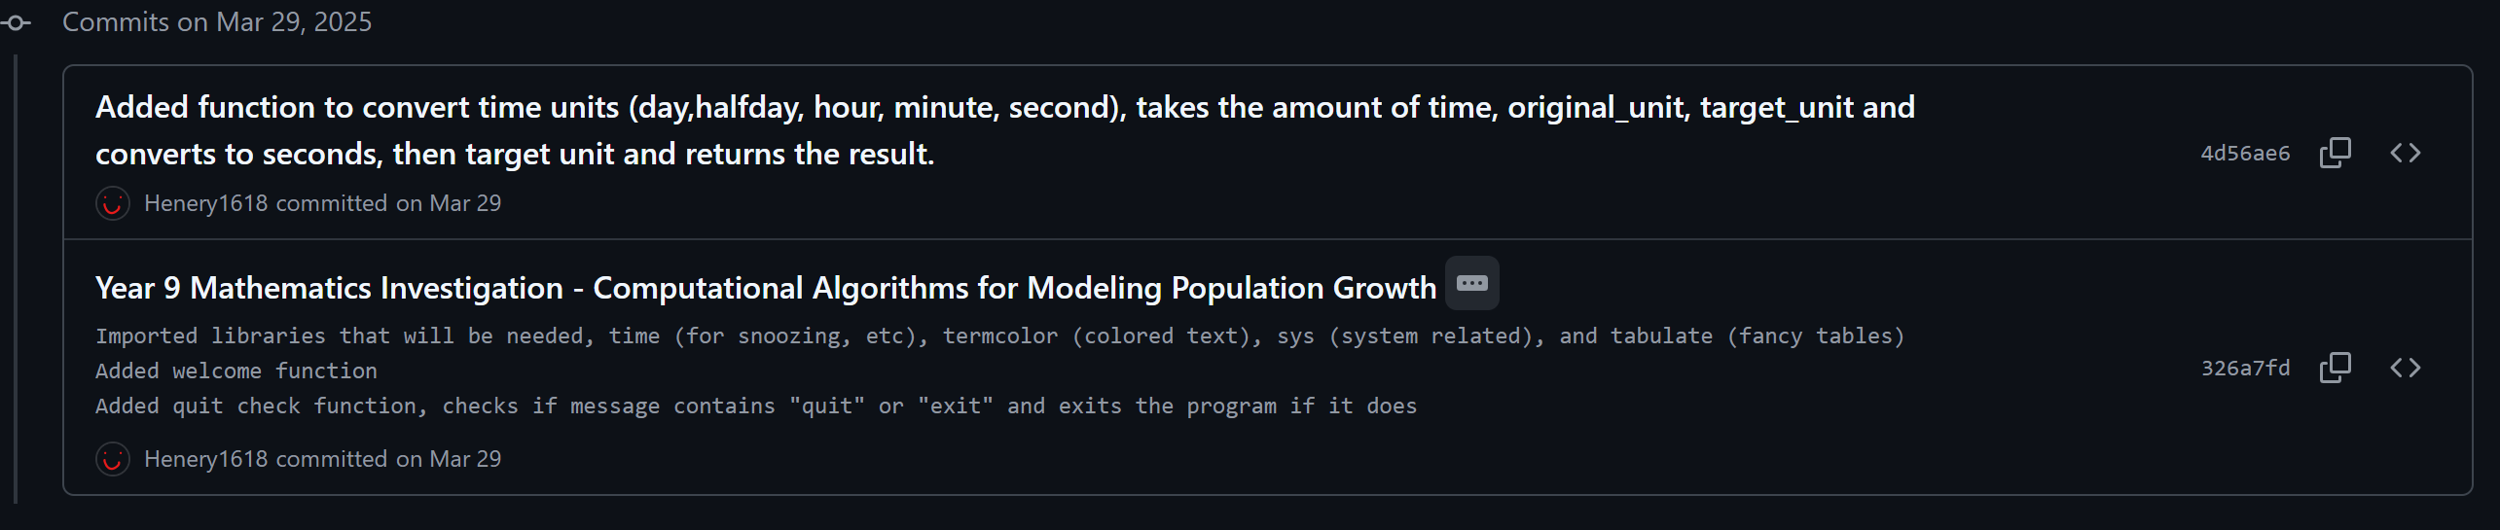
Commits (backwards in time) – Henry Sun

Slide 3
Introduction – Naïve and Sophisticated growth
In this case, Naïve growth is just simple growth, with the formula I = P+PRT
Where I = final amount, P = starting amount, R = Interest rate, as a decimal, T = time period/amount of interest events.

Slide 4
Sophisticated growth
Sophisticated growth is basically just exponential growth, the interest applies on the total amount, aka interest applies on previous interest.
This can be represented with the formula: A = P(1+ r/n)^nt
A = final amount
P = Initial amount
r = growth rate, in decimal
n = the amount of interest applied per t (time period)
t = number of time periods

Slide 5
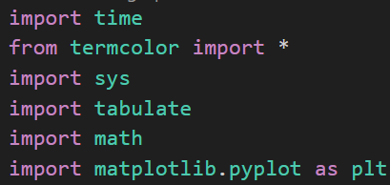
Part 0.1: Imports
I have a few imports, including:
Time, for sleeping the program
Termcolor, colored text
Sys, for exiting the program
Tabulate, to generate good looking and efficient tables
Math, Math is *ONLY* used for .floor(), which rounds down, and .log10(), which is a logarithm
Matplotlib, for graphs

Slide 6
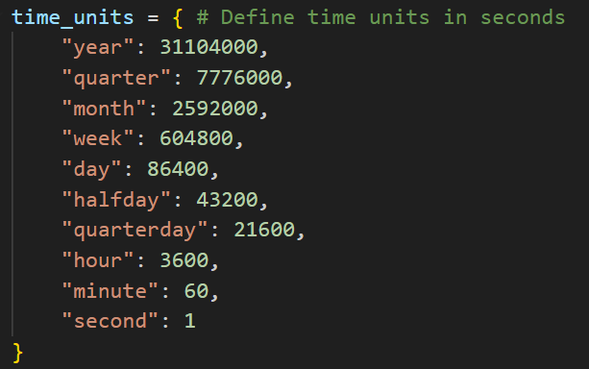
Part 0.2 – Converting Time units
To convert time units, my idea was to convert the value to seconds, and then multiply to the target time.
To do this, I first created a dictionary with the seconds value of each time unit, shown to the side

Slide 7
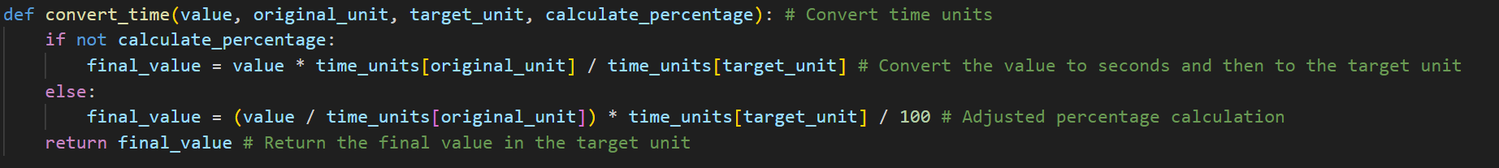
Part 0.2 – Converting Time units
I then added a function to convert the time, taking the original unit and time in that unit, then the target unit.
Calculate percentage is a Boolean (true or false), that is used so if I am calculating percentage (100% of a day, to hours for example), it uses a different formula.
The formula for basic conversion I used, is
Final value = value * time_units[original_unit]/time_units[target_units]
When substituted, it results in (with the inputs being 100, hours, days, False), meaning I want to convert 100 hours into days, without calculating it as a percentage.

Slide 8
Part 0.2 – Converting Time units
This means, when substituted, final_value = 100 * time_units[“hours”]/time_units[“days”]
After getting the values from the dictionary, it results in
Final value = 100 * 3600/86400
Final value = 4.1666666667
Percentage is similar, but changed to meet the logic of percentages

Slide 9
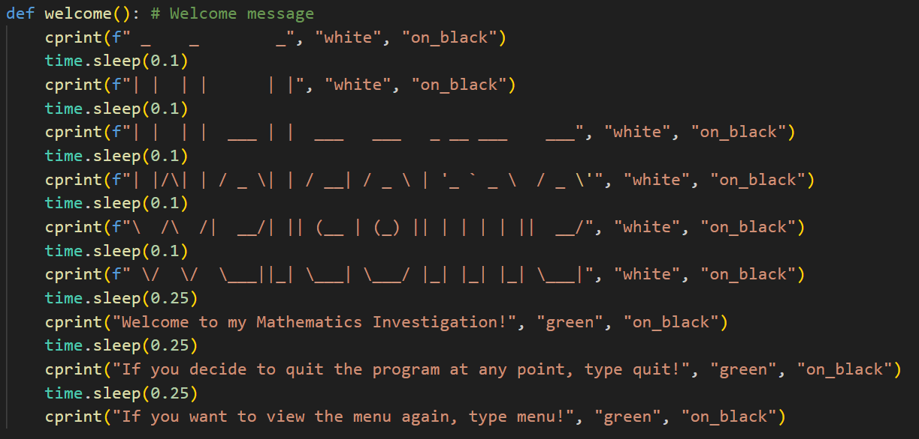
Part 0.3 – Welcome menu
If you haven’t figured already, I put basically everything into a function, and so is the welcome screen
This prints out a simple welcome message

Slide 10
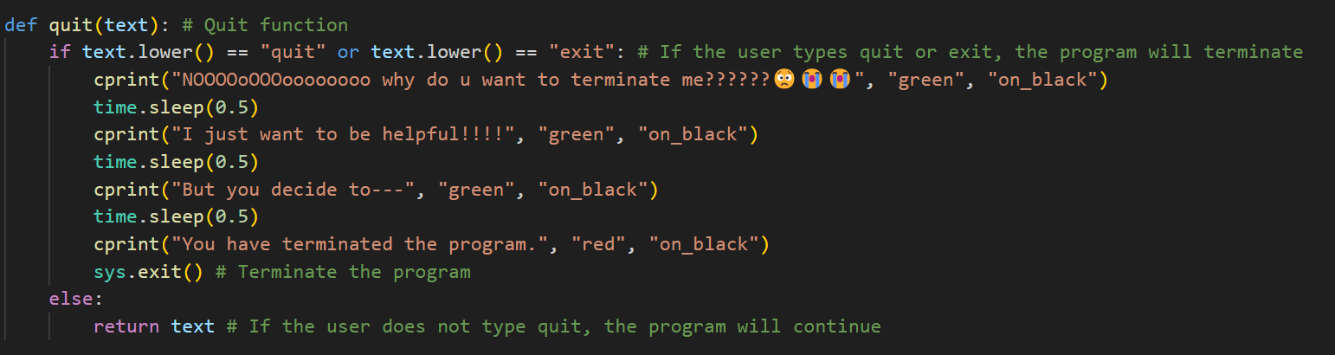
Part 0.4 – Quit() function
When quit(message) is used, it checks if the message is “quit” or “exit”, and if it is, it terminates the program. If it isn’t, the original message gets returned, as if the quit() was not there

Slide 11
Part 0.4 – Quit() function
For example,
If I did
Message = quit(input(“Hi, Please type a message! “))
If the user typed in quit, the function detects it, and exits.
However if it doesn’t, it sends back the message, meaning it does not affect it.

Slide 12
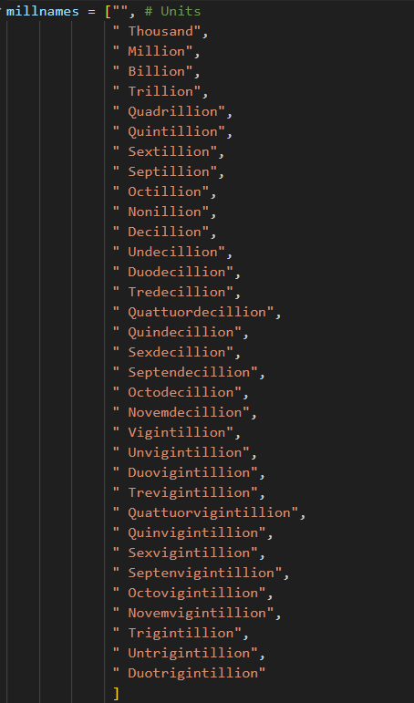
Part 0.5 – Millify()
My function, Millify, converts numeric values, such as 1,000,000,000,000 into 1 Trillion (example)
It starts with a list of every –illion name until 10^99
Each one is an increment of 10^3, or 3 digits

Slide 13
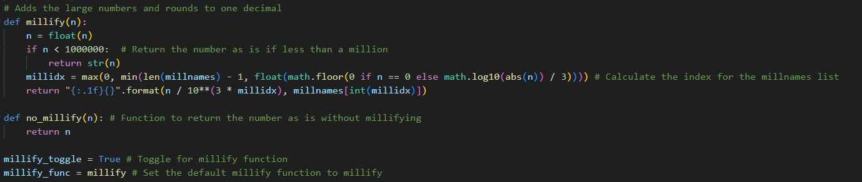
Part 0.5 - Millify
This function, takes a number, converts it to a float, and if the number is not less than 1,000,000 (because otherwise not precise enough), it converts to the –illion name.
math.log10(n)/3, gets the amount of digits, and divides by 3, meaning it gives the index of the correct –illion name in the list.

Slide 14
Part 0.5 - Millify
The number is scaled down by dividing it by 10**(3 * millidx), so that it fits the corresponding suffix.
{:.1f} ensures the output is rounded to one decimal place.
Finally, the appropriate suffix from millnames[millidx] is appended
(I think I did something with the max and min, but don’t remember, its prolly useless now)

Slide 15
Part 0.5.1 – No Millify
I added a toggle for mollify, so you can enable/disable it.
This works because of a placeholder function, no_millify(n)
If millify is set to false, it uses no_millify in millify_func(), which I use to wrap around the population numbers.
No_millify just returns the value
So If I had:
Millify_func(100000000)
If millify_func = millify, it would run millify
Otherwise, it would return itself.

Slide 16
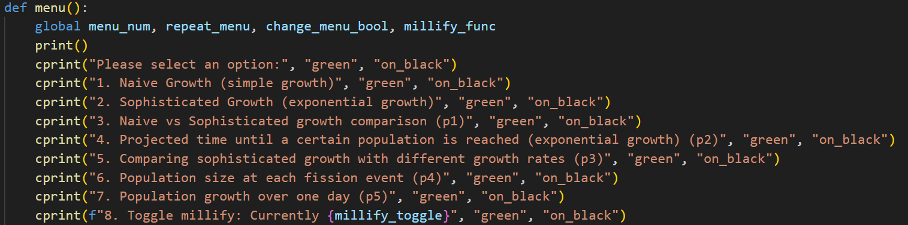
Part 1 – Menu system
My menu system is in a function (surprise surprise)
And first prints out the options
Global variables are variables accessible in all areas of the code, while variables in a function (not declared global) are only stored in the function.

Slide 17
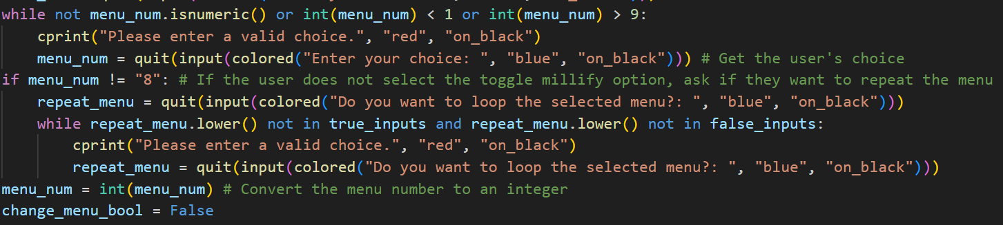
Part 1 – Menu system
Then it checks if it is within range, with reinputs if incorrect
Then it asks if you want to repeat the menu, so you do not have to keep selecting it (if you are not toggling millify)
It then sets the menu to the chosen, and the change menu bollean to false
Change menu bool is used when the user types menu in a random input, and turns it to true. Then because I have loops checking if change menu bool is true, it skips over code that would do any action, and goes to menu system

Slide 18
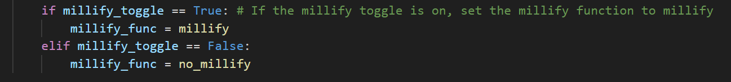
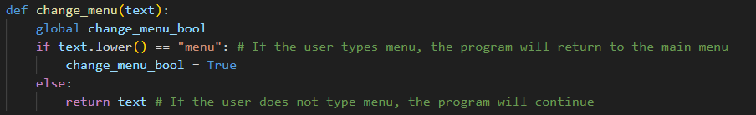
Part 1 - Menu
If you toggle millify, it sets it to true or false, the opposite of current settings (triggered by later main loop) (default: True)
When the menu needs to be changed, it runs this function to check if the user typed menu

Slide 19
Part 1.1 – Main Loop
My main loop begins with the welcome screen, then into a While True
Then every loop, it runs the menu
For each menu, while the menu is selected, it runs the code for it
If change_menu_bool is true, it means the user wants to change menu, and it breaks the loop.
This is the same for all the menu options, and the code for the functional part is different

Slide 20
Part 1.1 – Main loop
Menu 2, is a basic sophisticated growth calculator, and the rest are the parts of the investegation

Slide 21
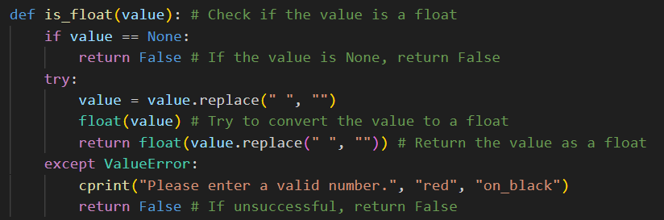
Part 1.2 – Input validation
First validation function, is is_float
This checksif the value is a float, and removes spaces.
If the value is none, (hard fix for an error), it returns false
If it is not a float, it returns false, and if it is, it returns the converted value

Slide 22
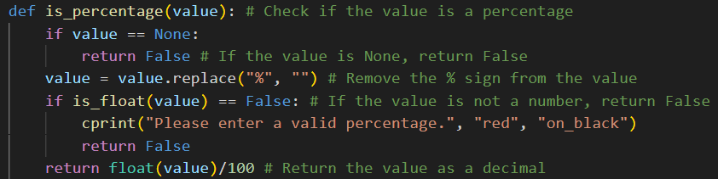
Part 1.2 – Input validation
Next, is is_percentage, and it changes percentage to decimal. It also changes whole number, 70 for example, into 0.7 (percentage_
Again, if it is not a percentage, it gets returned as false, and if it is, it returns the formatted value

Slide 23
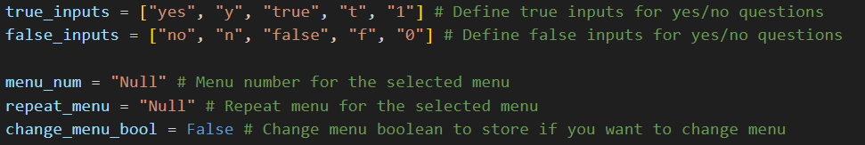
Part 1.2 – Input validation
Next is checking input time,
For my input time, the original method on the document was extremely confusing, so I did it like:
Initial population
Growth rate
How often is a fission event, (x units)
How long to project to (x units), or target population

Slide 24
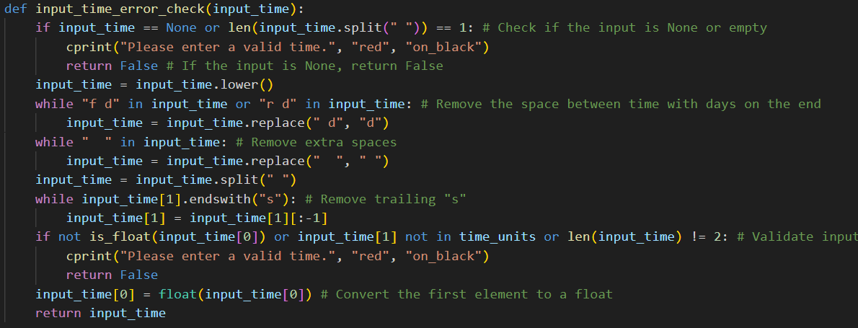
Part 1.2 – Input validation
First, it tries splitting the string, eg “5 days”, into [“5”, “days”], and if there is only one value, it returns false
Then it removes the space in half days and quarter days, into halfdays and quarterdays
It then removes extra spaces
It removes any trailing “s”, and check that the first value is a float, and second is a string.
Then it returns
the values as a list

Slide 25
Part 1.3 - Inputs
My inputs are all received in a function, and the parameters are the menu, so if it was a target population, it would not ask for a projection time, etc

Slide 26
Part 1.3 - Inputs
The reason for change menu bool == False, is if the user wants to change the menu, it doesn’t print unnecessary information or inputs that stop it from going to the menu screen
It validates the inputs and then continues
Initial population is needed for everything, so there was no other condition in the loop

Slide 27
Part 1.3 - Inputs
For the total of one day one, part 5, it does not need a growth rate, so it gets excluded
Other stuff is similar to before

Slide 28
Part 1.3 - Inputs
Then, time for each growth period is also needed for everything

Slide 29
Part 1.3 - Inputs
Then time to project (if needed)
It then returns value as a list, because all the inputs are done

Slide 30
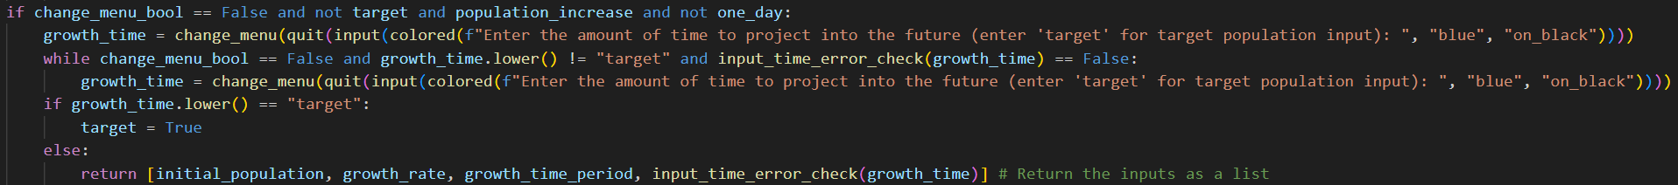
Part 1.3 - Inputs
This is a special case, for the part 5, where you can type “target”
There was no easy readable way to integrate with the previous input without sacrificing input validation, so this gets its special one

Slide 31
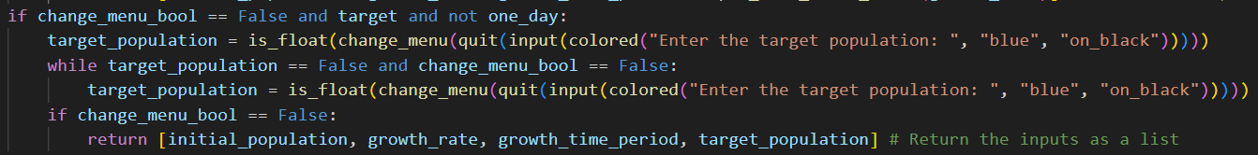
Part 1.3 - Inputs
Then, target population

Slide 32
Part 1.3 - Inputs
And finally, if the value hasn’t been returned yet, (part 5), it returns it

Slide 33
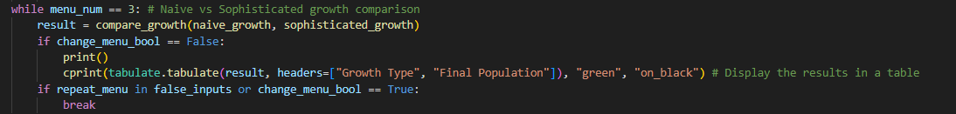
Part 2 – Comparing Naïve And Sophisticated growth
For this part, I used menu option 3
It runs the compart growth, which runs naïve and sophisticated growth
It prints the final result as a small table

Slide 34
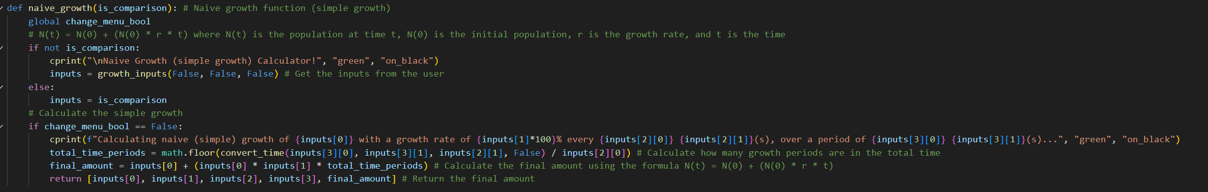
Part 2 – Comparing Naïve And Sophisticated growth
Firstly, this is naïve growth, it is a basic calculator that takes the inputs, using the previous function, and then calculates and returns the values

Slide 35

Part 2 – Comparing Naïve And Sophisticated growth
Naïve growth is simple growth, so if I had 5 andres
At a growth rate of 20% every hour, for 5 hours, at hour one, I would have 20% more
And, next, it continues to grow, however, only by the same amount, as it is 20% of the original amount, this means I would only have 10 andres

Slide 36
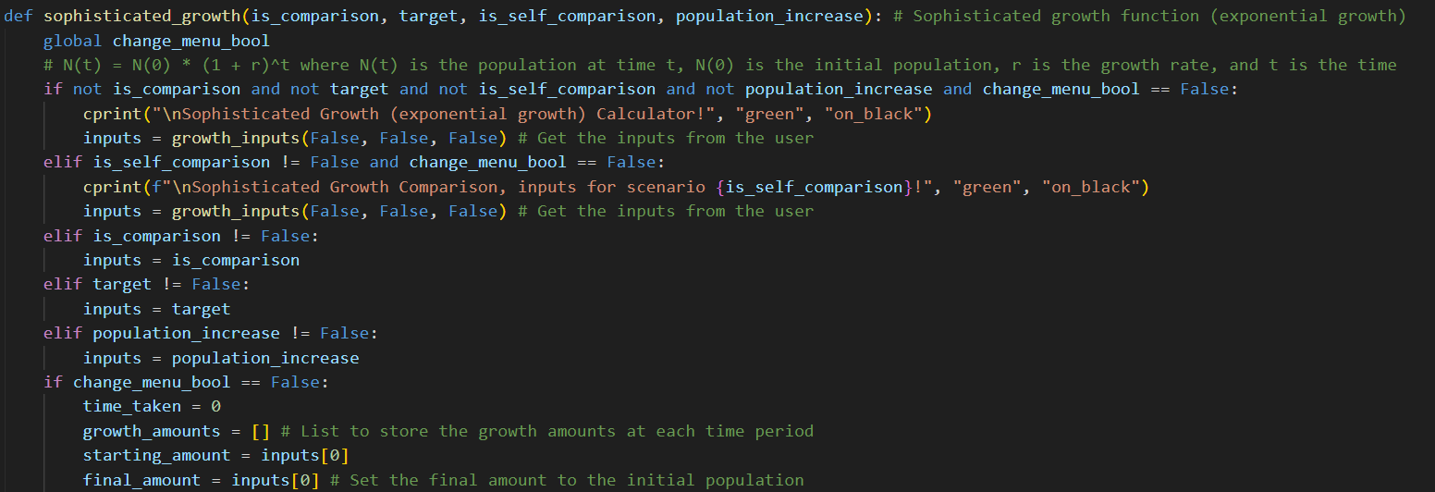
Part 2 – Comparing Naïve And Sophisticated growth
Next is sophisticated/exponential growth, which is split into two parts, taking the inputs depending on the situation, and setting the variables up
The parameters are similar to the inputs function, where it enables/disables a line using a loop if it requires so
These parameters are either False, or contain the list if true

Slide 37


Part 2 – Comparing Naïve And Sophisticated growth
Sophisticated growth is exponential, meaning growth applies to previous growth, so back to the example, 5 andres
At a growth rate of 20% every hour, for 5 hours, at hour one, I would have 20% more
But then, I wouldn’t just gain one more, I would gain 20% of the new amount, which is 1 and 1/5 more
And so on
Eventually, I would have 12.5 andres instead of 10, meaning it gives better rates

Slide 38
Part 2 – Comparing Naïve And Sophisticated growth
However, more events of growth, does not mean it can get infinitely larger, it will always reach a point where growth cannot go more, also known as Euler’s number , or e (2.71828)
Again, all of these functions were present near the start, and were slightly modified for the requirements of the task
The modality of the code will be shown later, in later part

Slide 39
So you are safe from this…. For now….

Slide 40
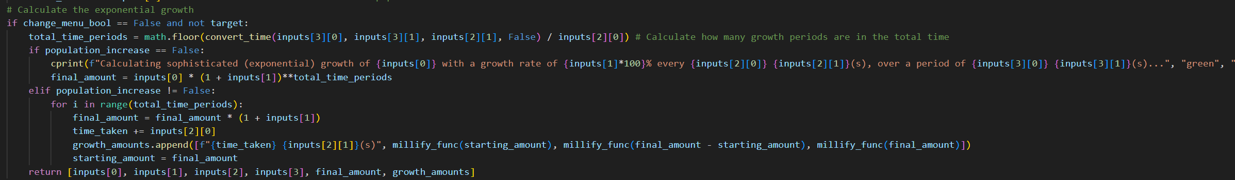
Part 2 – Comparing Naïve And Sophisticated growth
Then, if there is no target population, it calculates the exponential growth
First, it calculates the amount of total growth periods there are, converting time units
If it is only calculating the result, it uses the formula, but if it is not, it loops the formula instead of an exponent

Slide 41
Part 2 – Comparing Naïve And Sophisticated growth
for the loop, each time period means it grows/multiplies the population by 1+growth rate percentage, and then appends it to a list.
It appends the time, starting amount, mollified or not, growth, and closing population
It also returns all the data, ot be used where the function was called

Slide 42
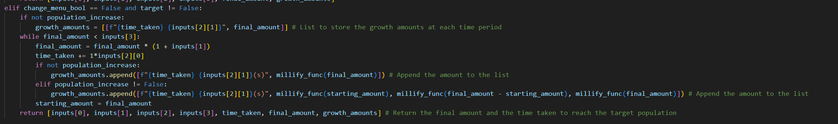
Part 2 – Comparing Naïve And Sophisticated growth
Howevver, if it is calculating a target, it keeps multiplying by 1+growthratepercentage, until it meets or exceeds the targets.
The data is then returned

Slide 43
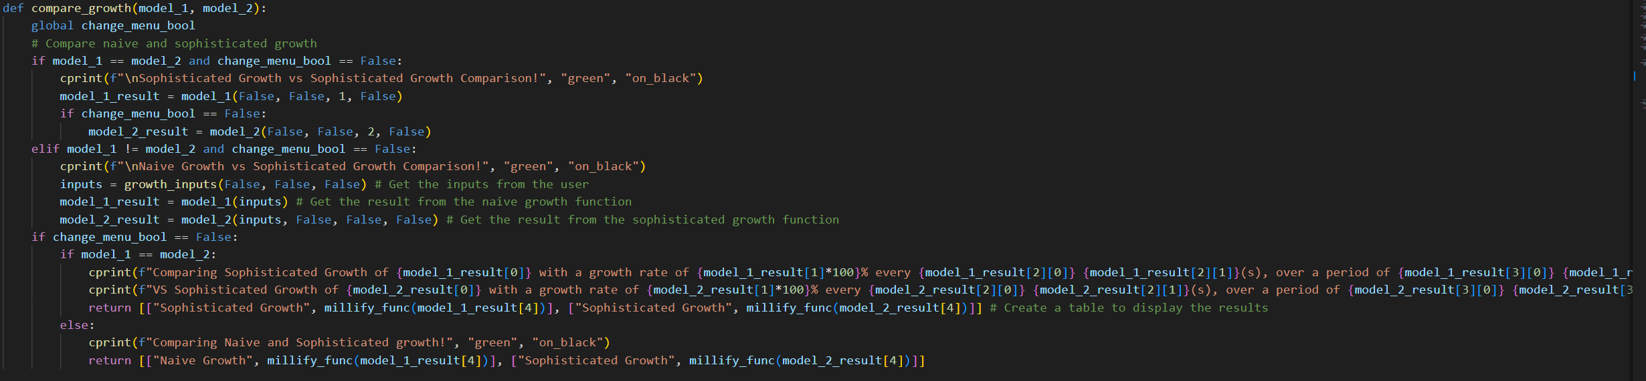
Part 2 – Comparing Naïve And Sophisticated growth
Next, is the compare_growth() function, which takes model 1 + 2, and then runs them. Model 1 + 2, is just the function, put in the parameters
It prints out the appropriate title, and gets inputs, calculates results, prints basic data, and returns data & results

Slide 44
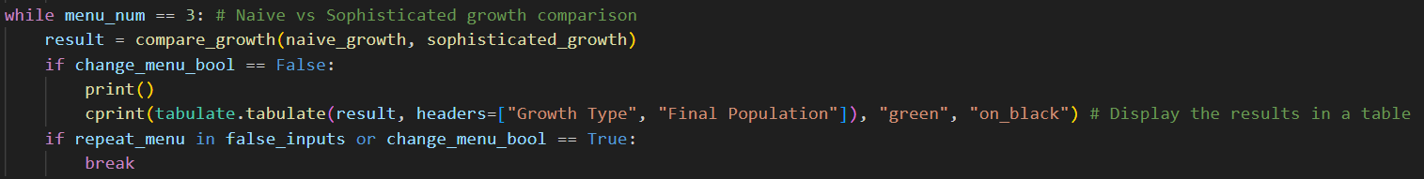
Part 2 – Comparing Naïve And Sophisticated growth
Again, back to the main loop, it calls the previous function and runs the code

Slide 45
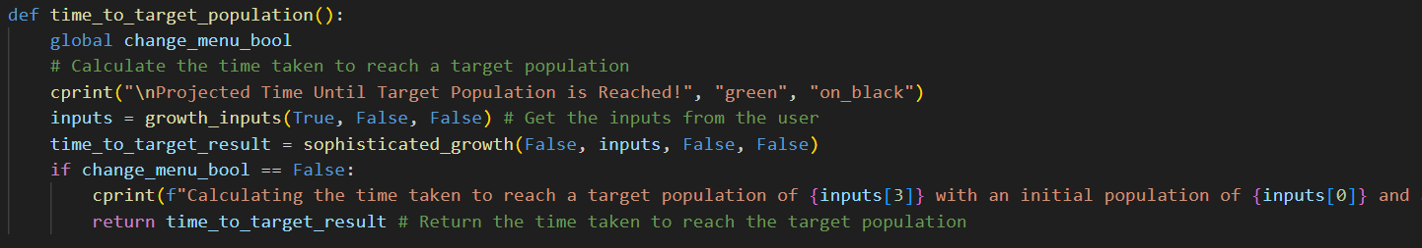
Part 3 – Target population
Calculating the time for a target population was covered in the sophisticated growth function, and this just gets the inputs, and calls the function
It prints info, and returns the results

Slide 46
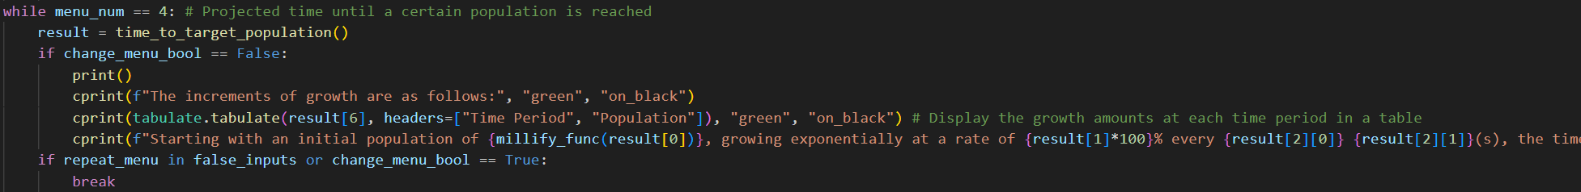
Part 3 – Target population
In the main loop, it was similar, and printed as a table

Slide 47
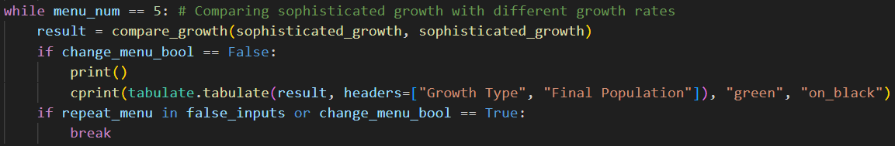
Part 4 – Comparing sophisticated growth
Calculating the comparison of the sophisticated growth uses the same function as before, part 2
This is the main loop part, it calls the function

Slide 48
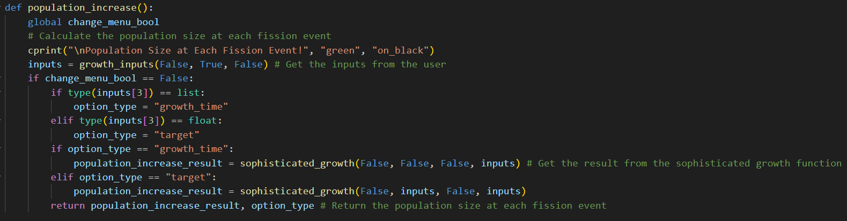
Part 5 – Population size at each fission event
This is my function to calculate population increase, it just calls the sophisticated growth function and puts it all together, like before

Slide 49
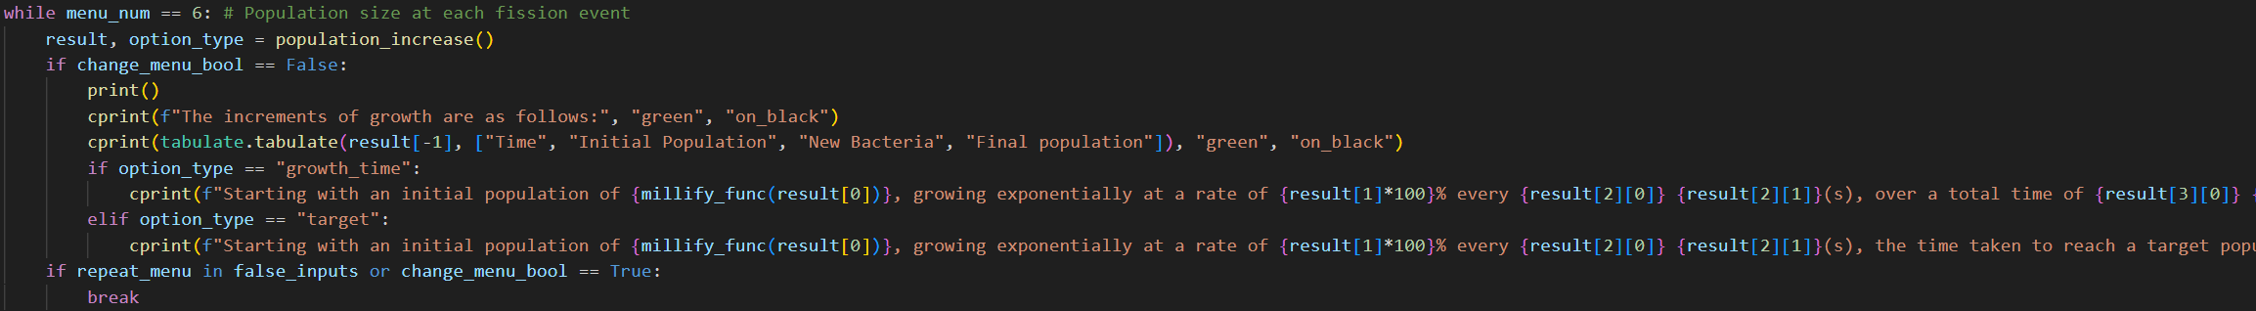
Part 5 – Population size at each fission event
This is it in the main loop, same as before

Slide 50
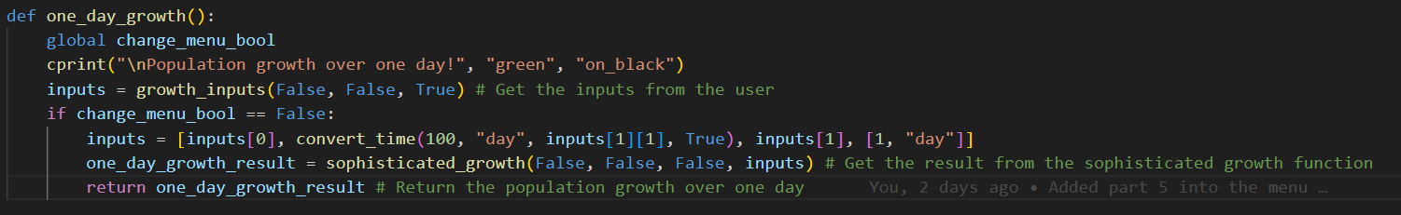
Part 6 – Population growth over one day
This again reuses the sophisticated growth, but for the inputs, it just forces 100% per day, and time to simulate

Slide 51
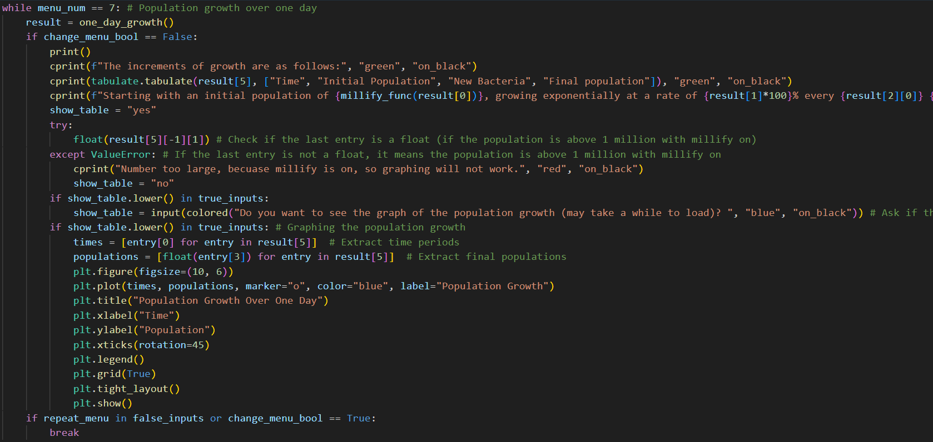
Part 6 – Population growth over one day
This again prints the result, and if allowed, it will ask to generate a table

Slide 52
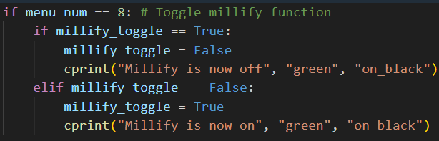
Part 7 – Toggle Millify
This just sets the toggle to the other one, and it changes it in the menu function

Slide 53
Example interaction :D
(not bothered to put on slides so watch the code)

